Slide 1


James Chenery
2022-11-11

Slide 2

Outline
Executive Summary
Introduction
Methodology
Results
Conclusion
Appendix

Slide 3
Executive Summary
Summary of methodologies
Data collection
Data wrangling
EDA with data visualization
EDA with SQL
Building an interactive map with Folum
Building a dashboard with Plotly Dash
Summary of all results
EDA results
Interactive analytics
Predictive analysis

Slide 4
Introduction
Project background and context
Our startup aerospace company is competing with SpaceX, a manufacturer and operator of commercial space launch vehicles, and we are currently bidding against them for a space launch contract.
SpaceX advertises Falcon 9 rocket at a cost of 62 million dollars while other providers cost upward of 165 million dollars each.
Problems you want to find answers
Much of the SpaceX’s savings are due to reusing the first stage.
We need to predict the probability of SpaceX Falcon 9 first stages landing successfully (and thus being reuseable) in order to make more informed bids against SpaceX for a rocket launch.

Slide 5

Section 1

Slide 6
Methodology
Executive Summary
Data collection methodology:
JSON data was obtained via GET requests to the SpaceX API
HTML data was obtained from Wikipedia via Beautiful Soup
JSON/HTML data -> Normalized Pandas data frame
Performed data wrangling
Removed non-Falcon 9 launch records, removed unneeded columns, handled null values by replacing 5 missing Pay Load Mass values with the mean average. Used One Hot Encoding to prepare data for machine learning
Performed exploratory data analysis (EDA) using visualization and SQL
Performed interactive visual analytics using Folium and Plotly Dash
Performed predictive analysis using classification models
LR, KNN, SVM and DT models were compared for best classifier

Slide 7
Data Collection
SpaceX data was collected from two sources:
Spacexdata.com who provide SpaceX data via calls to the r/SpaceX API
https://docs.spacexdata.com/
Wikipedia.com’s SpaceX Falcon 9 launches list page, which contains a table of launch data, which was scraped using Beautiful Soup
https://en.wikipedia.org/wiki/List_of_Falcon\_9\_and_Falcon_Heavy_launches
API CALLS
JSON Object
Pandas Data Frame
Data Wrangling
HTTP REQUEST
HTML / Beautiful Soup
Dictionary

Slide 8
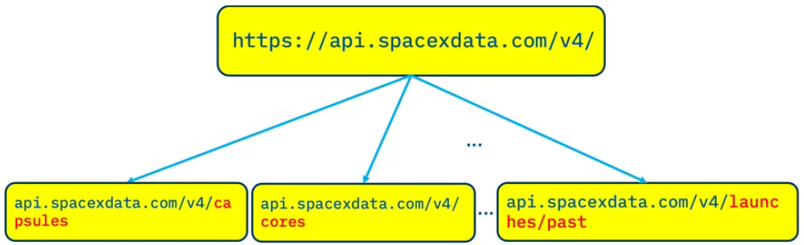
Data Collection – SpaceX API
API documentation: https://github.com/r-spacex/SpaceX-API/tree/master/docs#rspacex-api-docs
REST call (GET) sent to four API endpoints:
Root, rocket, payload, launchpad, cores
Rocket, payload, launchpad and cores are supplementary calls used to append data to root response by using ID values (e.g. rocket) as key indexes via functions
Each JSON response is normalized into a Pandas data frame, ready for wrangling in Python
GET request to API
JSON response
Normalized Pandas Data Frame
Python Notebook:
https://github.com/james-chenery/IBM-Data-Science/blob/22b68ad89cc1a5d5dec333927d1fecd790d35dd5/API-data-collection.ipynb

Slide 9
Data Collection - Scraping
Beautiful Soup documentation: https://beautiful-soup-4.readthedocs.io/en/latest/
HTTP GET method requested the Falcon9 Launch Wikipedia HTML page, as an HTTP response
Created a Beautiful Soup object from the HTML response
Created a list of all HTML tables from the Beautiful Soup object by using the find_all function with element type ‘table’
Identified and extracted the launch records table
Used the find_all function with element type ‘th’ to create a list of column values
Initialized dictionary with column values, assigned an empty list to each dictionary value and then populated those lists from the table with find_all
Created a Pandas data frame from the dictionary
HTTP GET request
https://en.wikipedia.org/w/index.php?title= List_of_Falcon_9_and_Falcon_Heavy_launches &oldid=1027686922
Beautiful Soup Object
Extract list of HTML tables
Extract contents of launch records table
Create dictionary of table contents
Create Pandas data frame from dictionary
Python Notebook:
https://github.com/james-chenery/IBM-Data-Science/blob/a95323eb315de1ffe238ea4dc9a7ec18a32b8354/Webscraping.ipynb

Slide 10
Data Wrangling
Steps of Data Wrangling
Check for null values
For each launch site, calculate the number of launches
For each orbit, calculate the number of launches
For each orbit, outcome and calculate the number of missions
Add a binary Class column for success/failure of landing outcomes
Remove null values
Python Notebook:
https://github.com/james-chenery/IBM-Data-Science/blob/106fd6ac33aa17fbbc8d3f337f6f0a1b3a71675f/wrangling.ipynb

Slide 11
EDA with Data Visualization
Summary of Data Visualizations
Launch Site vs. Flight Number Scatter Plot: To visualize the relationship between Flight Number and Launch Site
Launch Site vs. Pay Load Scatter Plot: To visualize the relationship between Payload and Launch Site
Success vs. Orb Bar Chart: To visualize the relationship between success rate of each orbit type
Orbit vs. Flight Number Scatter Plot: To visualize the relationship between FlightNumber and Orbit type
Orbit vs. Pay Load Scatter Plot: To visualize the relationship between Payload and Orbit type
Success vs. Year Line Chart: To visualize the launch success yearly trend
Python Notebook:
https://github.com/james-chenery/IBM-Data-Science/blob/366f6ed7d0dee8f09c18470ba37f61e2428823e6/EDA-DATAVIZ.ipynb

Slide 12
EDA with SQL
Queries performed:
Displayed the names of the unique launch sites in the space mission
Displayed 5 records where launch sites began with the string 'CCA'
Displayed the total payload mass carried by boosters launched by NASA (CRS)
Displayed the average payload mass carried by booster version F9 v1.1
Listed the date when the first successful landing outcome in ground pad was achieved
Listed the names of the boosters which have success in drone ship and have payload mass greater than 4000 but less than 6000
Listed the total number of successful and failure mission outcomes
Listed the names of the booster_versions, which have carried the maximum payload mass, with a subquery
Selected month names, failure landing_outcomes in drone ship ,booster versions and launch_site for months in year 2015
Ranked the count of successful landing_outcomes between the date 04-06-2010 and 20-03-2017, in descending order
Python Notebook:
https://github.com/james-chenery/IBM-Data-Science/blob/366f6ed7d0dee8f09c18470ba37f61e2428823e6/EDA-SQL.ipynb

Slide 13
Build an Interactive Map with Folium
A folium map was created with:
Circle markers and labels to indicate launch sites
Lines to indicate proximity to the nearest coast, railway line station/terminus, highway exit, city-designated residential area and civil airport from Cape Canaveral
Distance values were appended to the proximity lines
Markers were added to each launch site to indicate each launch from that site and whether or not it was successful.
The non-interactive versions in this report were supplemented with:
Magnified views
Circles and arrows were added to indicate launch region each magnified view related to
Python Notebook:
https://github.com/james-chenery/IBM-Data-Science/blob/31d1dce129b0959548c8ebb58ed251129d0749aa/EDA-Launch_Site.ipynb

Slide 14
Build a Dashboard with Plotly Dash
The dashboard is comprised of:
Pie chart showing the total successful launches vs. launch site
Interactive drop down to select all sites or specific sites
Scatter graph showing launch outcomes vs. booster version
Interactive slider to select a payload mass (kg) range
The dashboard was constructed in order to answer these questions:
Which site has the largest number of successful launches?
Which site has the highest launch success rate?
Which payload range(s) have the highest launch success rate?
Which payload range(s) have the lowest launch success rate?
Which F9 Booster version (v1.0, v1.1, FT, B4, B5, etc.) has the highest
launch success rate?
Python File:
https://github.com/james-chenery/IBM-Data-Science/blob/f8529265f6dfa534575b05d58849f4a480ba87c2/dashboard.py

Slide 15
Predictive Analysis (Classification)
Load data with Numpy and Pandas
The data was loaded using numpy and pandas. It was transformed and split into sets for training and testing.
Four different machine learning models were built and their hyperparameters tuned using GridSearchCV.
The model with the highest accuracy was chosen as the best performing classification model.
Standardized the data
Split the data into training and testing sets
Created LR, SVM, KNN and DT models
Tuned the hyperparameters with GridSearchCV
Compared the models and identified the best performing classification model
Python Notebook:
https://github.com/james-chenery/IBM-Data-Science/blob/96a07f7a5717480f9de24c19483b497727169ef2/ML-Prediction.ipynb
Results

Slide 16
Results
Exploratory data analysis results
Interactive analytics demo in screenshots
Predictive analysis results

Slide 17

Section 2

Slide 18
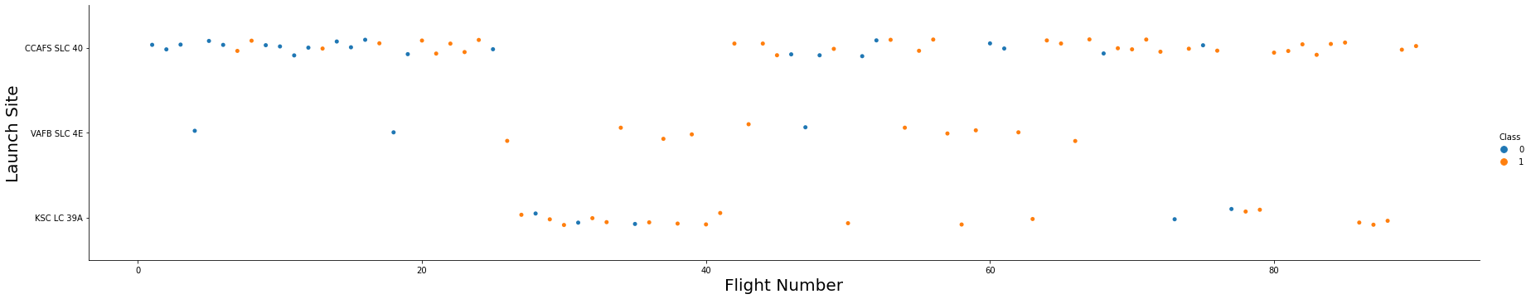
Flight Number vs. Launch Site
CCAFS SLC-40
KSC LC-39A
Flights alternate between CCAFS SLC-40 and KSC LC-39A, with occasional flights from VAFB SLC-4E.

Slide 19
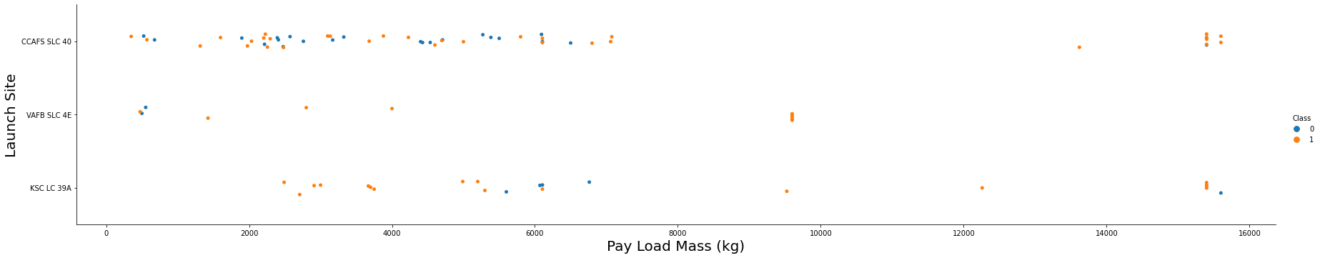
Payload vs. Launch Site
Launch Site Versus Pay Load Mass (kg)
CCAFS SLC-40
VAFB SLC-4E
KSC LC-39A
The main launch sites are CCAFS SLC-40 and KSC LC-39A, with what might be test flights from VAFB SLC-4E.
No heavy flights (10,000 kg or more) fly from VAFB SLC-4E.

Slide 20
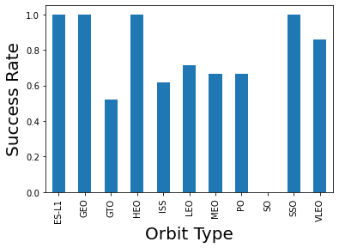
Success Rate vs. Orbit Type
Success Rate Versus Orbit Type
ES-L1, GEO, HEO and SSO have a 100% success rate.
VLEO is over 80% success rate.
LEO, MEO, PO and ISS around a 65% success rate. The GTO orbit has the worst success rate at 50%.

Slide 21
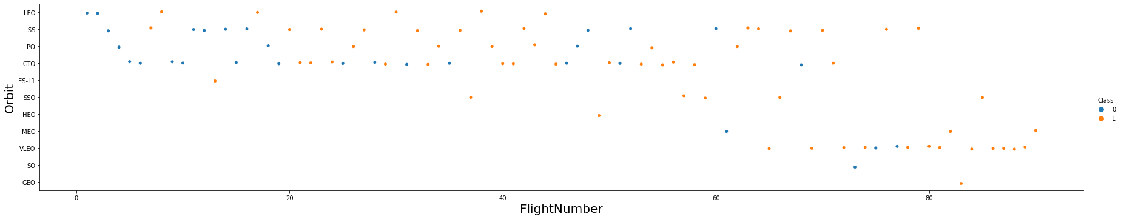
Flight Number vs. Orbit Type
Success Versus Flight and Orbit Type
LEO
ISS
PO
GTO
ES-L1
SSO
HEO
Success Failure
MEO
VLEO
SO
GEO
21
The earlier a flight is, among all SpaceX flights, the more likely it is to fail. The earlier a flight is for a specific orbit, the more likely it is to fail.
There seems to be a strong correlation between experience and success.

Slide 22
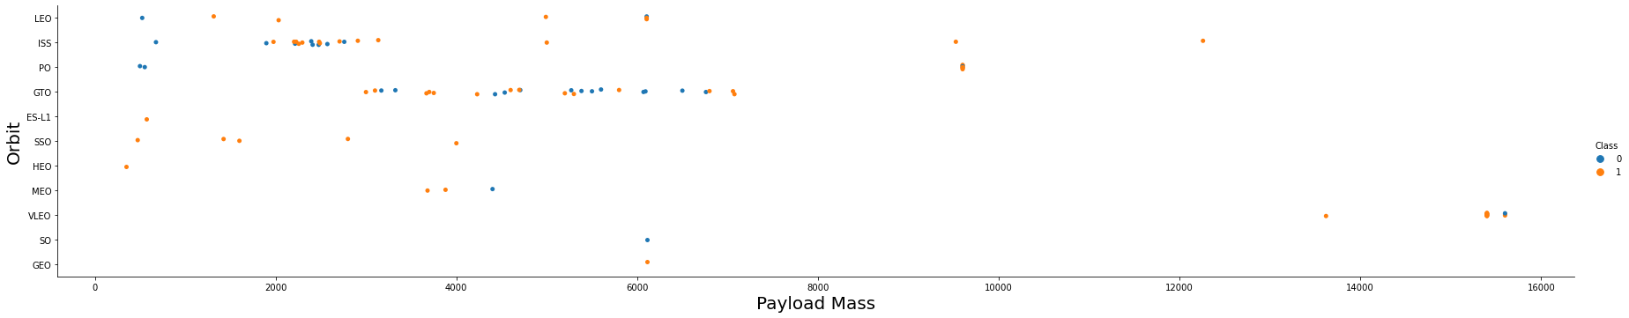
Payload vs. Orbit Type
Success Mixed Failure
LEO, ISS, PO and GTO began with a few light failures which may have been test/demo flights. PO and GTO have mixed performance for heavier payloads
ES-L1, SSO, HEO, VLEO and GEO were successful regardless of payload.

Slide 23
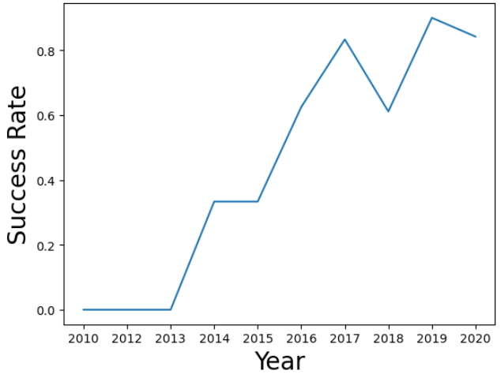
Launch Success Yearly Trend
Line Chart of Yearly Average Success Rate
The success rate kept climbing until 2020.

Slide 24
All Launch Site Names
 | Launch Site | Latitude | Longitude
0 | CCAFS LC-40 | 28.562302 | -80.577356
1 | CCAFS SLC-40 | 28.563197 | -80.576820
2 | KSC LC-39A | 28.573255 | -80.646895
3 | VAFB SLC-4E | 34.632834 | -120.610745
The two launch sites beginning with “CCAFS” are located on the east coast, within the launch facilities of Cape Canaveral Space Force Station (formerly Cape Canaveral Air Force Station.) KSC LC-39A is located close to the Kennedy Space Center’s Vehicle Assembly Building.
VAFB SLC-4E is located on the west coast, in Vandeburg Space Force Base (formerly Vandenberg Air Force Base.)

Slide 25
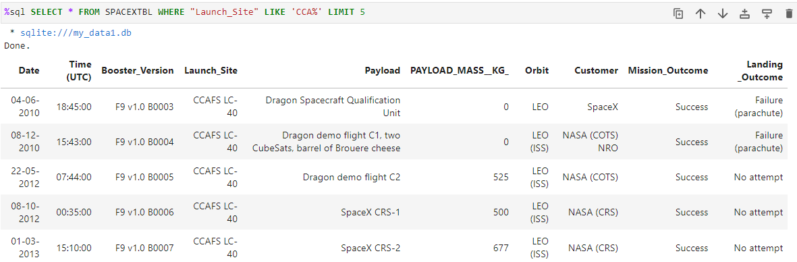
Launch Site Names Begin with 'CCA'
The first five launches from Cape Canaveral include three test flights.

Slide 26
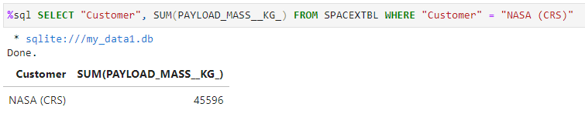
Total Payload Mass
The total pay load carried by SpaceX for NASA (CRS) in the data is 45,596 kg.

Slide 27
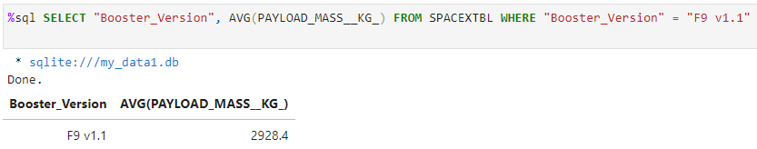
Average Payload Mass by F9 v1.1
The total average pay load returned for the basic v1.1 version of the F9 booster was 2,928.4 kg.

Slide 28
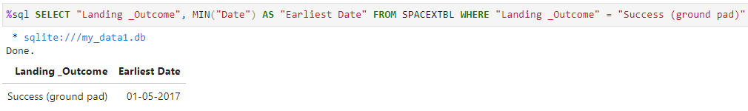
First Successful Ground Landing Date
The first successful F9 booster landing on a ground pad occurred on January 5th, 2017.

Slide 29
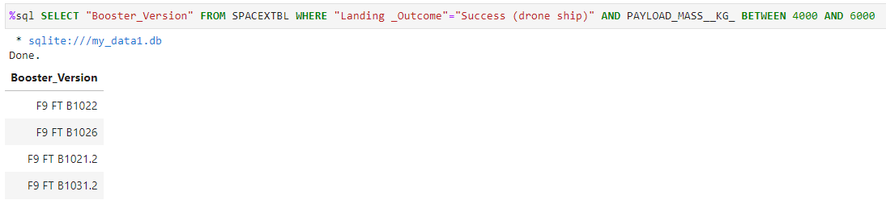
Successful Drone Ship Landing with Payload between 4000 and 6000
Four boosters have successfully landed on drone ship and had a payload mass greater than 4000 but less than 6000:
F9 FT B1022
F9 FT B1026
F9 FT B1021.2
F9 FT B1031.2

Slide 30
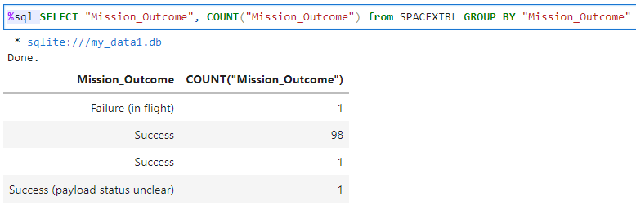
Total Number of Successful and Failure Mission Outcomes
There were 101 successful missions, and just 1 failure.

Slide 31
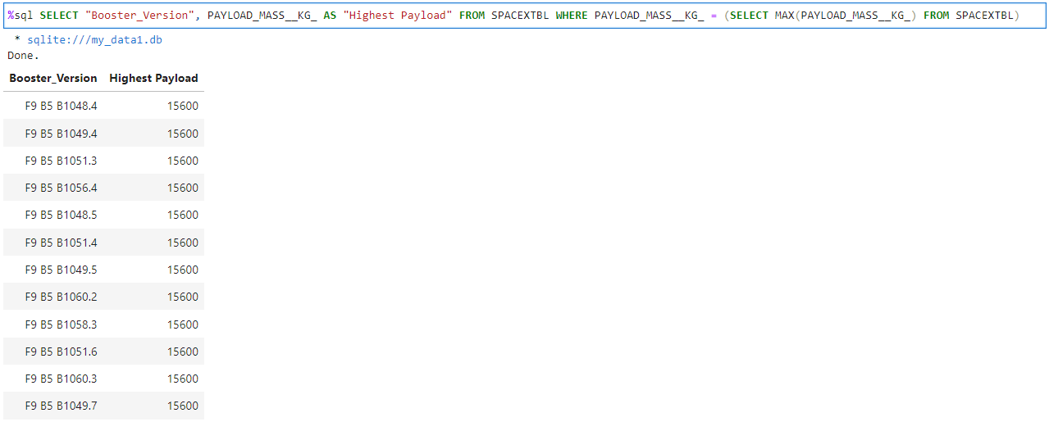
Boosters Carried Maximum Payload
This list contains the boosters which have carried the maximum pay load mass of 15,600 kg.

Slide 32
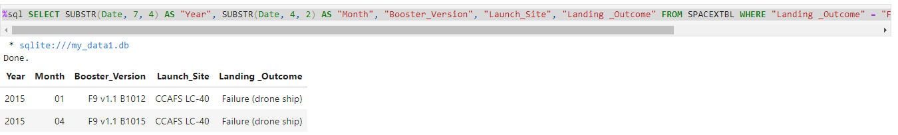
2015 Launch Records
This list contains the failed landing outcomes on drone ships in 2015, and the related booster versions, and launch site names
The query used was:
SELECT SUBSTR(Date, 7, 4) AS "Year", SUBSTR(Date, 4, 2) AS "Month", "Booster_Version", "Launch_Site", "Landing _Outcome" FROM SPACEXTBL WHERE "Landing _Outcome" = "Failure (drone ship)" AND SUBSTR(Date, 7, 4) = "2015"

Slide 33
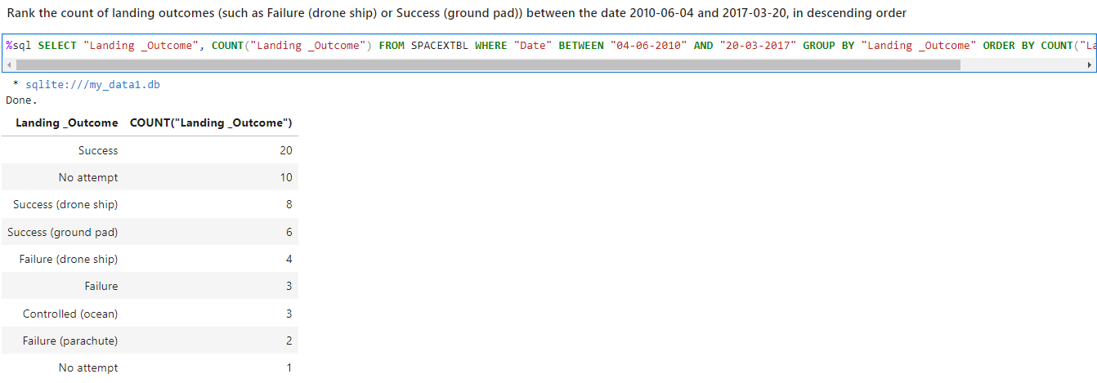
Rank Landing Outcomes Between 2010-06-04 and 2017-03-20
These landing results were obtained via the following query: SELECT "Landing _Outcome", COUNT("Landing _Outcome") FROM SPACEXTBL WHERE "Date" BETWEEN "04-06-2010" AND "20-03-2017“ GROUP BY "Landing _Outcome“ ORDER BY COUNT("Landing _Outcome") DESC

Slide 34

Section 3

Slide 35
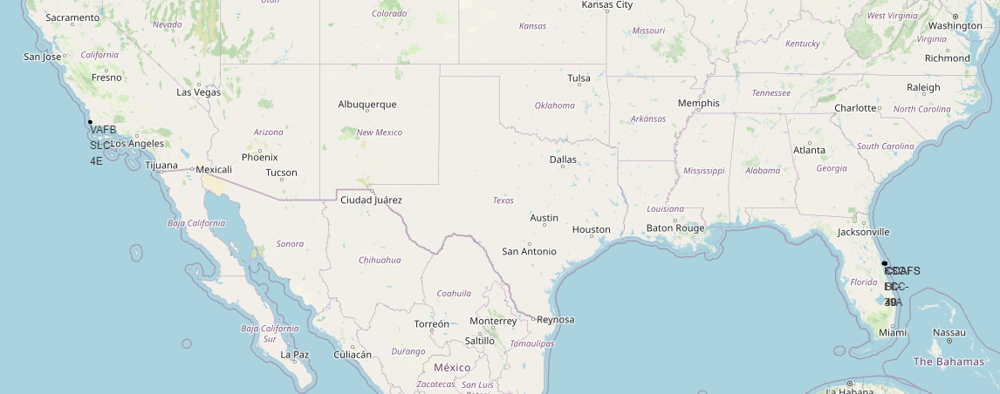
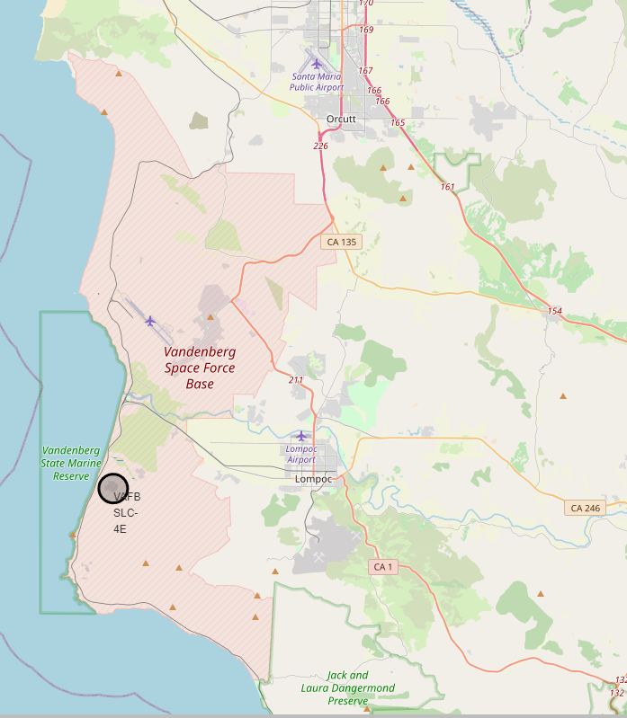
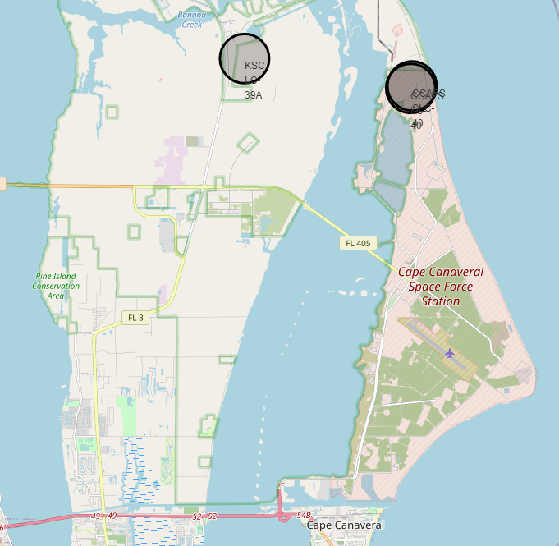
Launch Site Locations
KSC LC-39A
CCAFS LC-40
CCAFS SLC-40
Launch sites are located at:
Vandenburg Space Force Base
Kennedy Space Center
Cape Canaveral Space Force Station
VAFB SL-4E

Slide 36
Launch Site Proximity to the Equator
 | Launch Site | Latitude | Longitude
0 | CCAFS LC-40 | 28.562302 | -80.577356
1 | CCAFS SLC-40 | 28.563197 | -80.576820
2 | KSC LC-39A | 28.573255 | -80.646895
3 | VAFB SLC-4E | 34.632834 | -120.610745
4 | ELS-Soyuz | 5.30217 | -52.83337
Distance from Equator
3175.83 km
3175.93 km
3177.05 km
3850.81 km
589.55 km
The launch sites are not very close to the equator, so the additional cost of attaining most orbits must be offset by other factors, e.g. locally skilled workforce, security, accessibility, etc.
The equatorial ELS-Soyuz launch pad in French Guiana has been added for comparison.

Slide 37
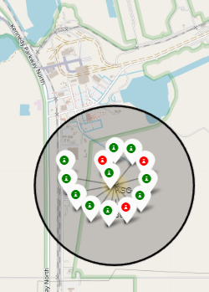
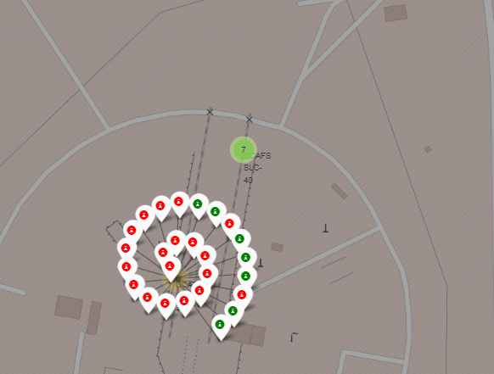
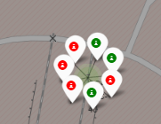
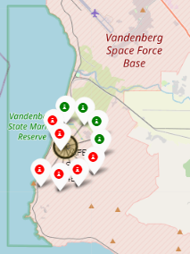
Launch Site Outcomes
KENNEDY SPACE CENTER
CAPE CANAVERAL SFS
VANDENBURG SFB
Kennedy Space Center has the best launch outcomes. The data includes the early failed test flights at Canaveral and Vandenburg

Slide 38
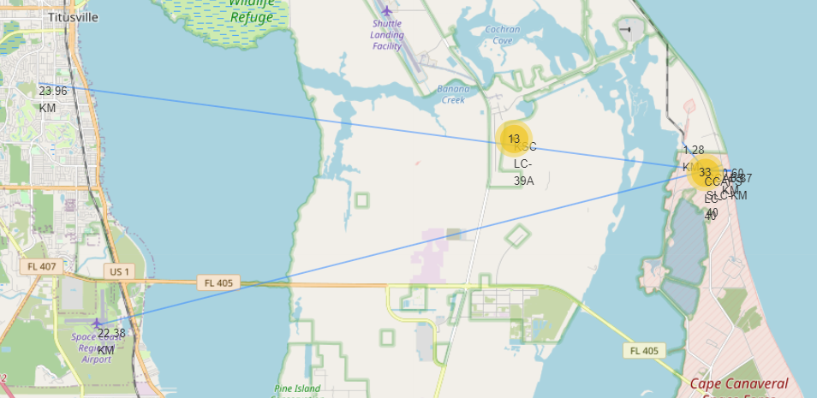
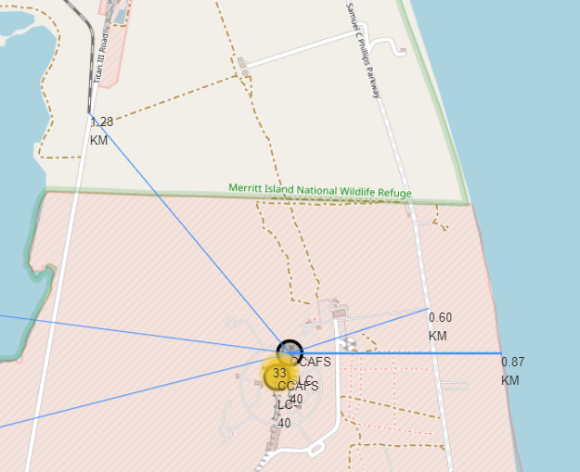
Cape Canaveral Launch Site Proximities Analysis
Titusville City (24.0 km)
Railway (1.28 km)
Space Coast Regional Airport (22.4 km)
Highway exit (596 m)
Coast (0.87km)
596.9 m
1.28 km
22.4 km
24.0 km
Closest_highway = [28.56483, -80.571] # Closest highway exit
Closest_railroad = [28.57205, -80.58524] # Railway Terminus
Closest_airport = [28.513560, -80.798769] # Space Coast Regional Airport
Closest_city = [28.591111, -80.82] # Titusville (City)
The launch site combines the benefits of excellent transportation links, a highly secure coastal location safely removed from heavily populated areas, and proximity to aerospace infrastructure and expertise.

Slide 39

Section 4

Slide 40
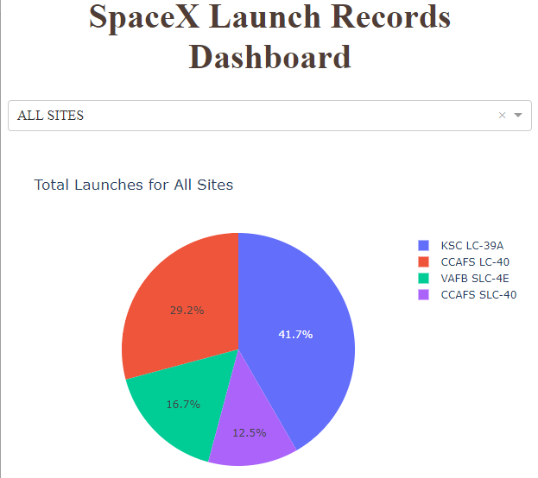
Interactive Dashboard (All Launch Sites)
KSC has 41.7% of all launches, however, it is not the most.
Cape Canaveral renamed LC-40 to SLC-40, so the pad’s total percentage is also 41.7%. KSC and CCAFS have therefore operated the same number of launches.
Vandenburg Space Force Base’s SLC-4E launch site is the third most used, at 16.7%.

Slide 41
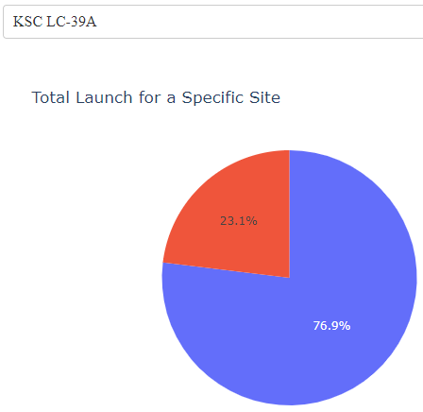
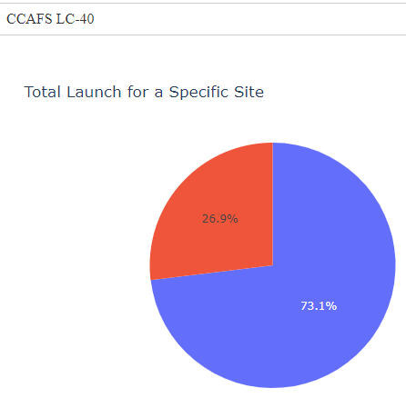
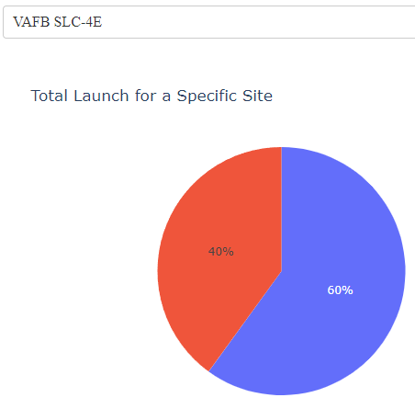
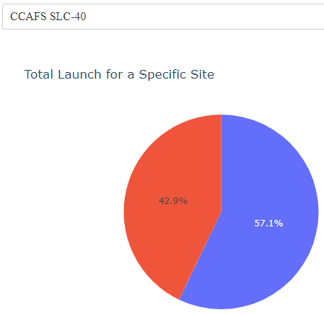
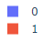
Interactive Dashboard (Landing Success Per Launch Site)
CCAFS SLC-40 has the best landing success rate at 42% (including test flights and deliberate no-landing launches.) CCAFS LC-40’s statistics pre-date SLC-40’s (due to the pad’s name change) and therefore likely include a lot of early test/demo launches.
VAFB SLC-4E has the second best landing success rate at 40%. CCAFS LC-40 and KSC LC-39A have lost 73.1% and 76.9% of boosters, respectively.

Slide 42
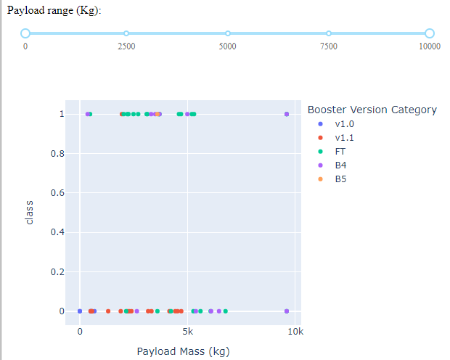
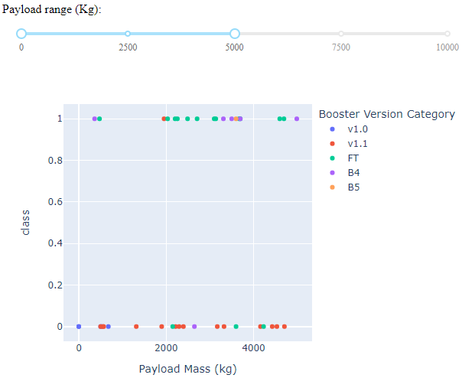
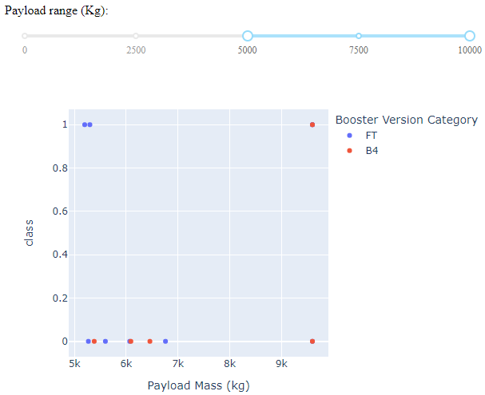
Interactive Dashboard (Payload vs. Success Scatter)
All Pay Loads
Pay Loads <5000 kg
Pay Loads >5000 kg
Successful landing of the first stage booster becomes increasingly unlikely as pay load increases, possibly indicating a lack of fuel for landing due to the additional mass.

Slide 43

Section 5

Slide 44
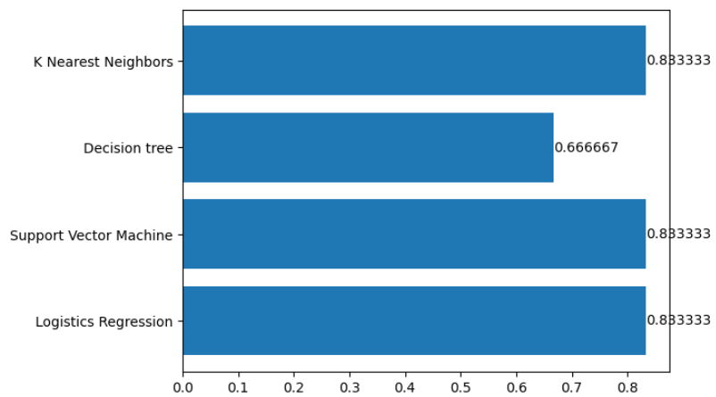
Classification Accuracy
The decision tree model has lower accuracy. The other three models were found to have equivalent accuracy.

Slide 45

Confusion Matrix
LR, SVM and KNN models had the best accuracy.
The confusion matrix shows that the classifier can distinguish between the different classes.
The major problem is the false positives .i.e., unsuccessful landing marked as successful landing by the classifier.

Slide 46
Conclusions
Initial launches to a given orbit had a high landing failure rate.
The most successful orbits for landing are: ES-L1, GEO, HEO, SSO and VLEO
The landing success rate increased from 2013 to 2020.
The current landing rate for all launches SpaceX’s Eastern launch facilities stands at 40-42%
From 2020, more launches failed to land as payloads tended to be heavier.
The exception are SSO orbit launches, which loft heavy loads, but have a flawless landing rate.
Launches with heavier pay loads (>5000 kg) have a greater probability of failing to land their boosters.

Slide 47
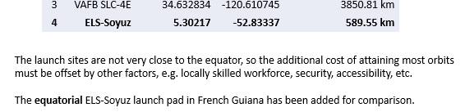
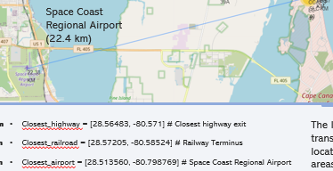
Appendix
Additional content have been interspersed into this presentation in appropriate places, e.g.
or:

Slide 48


